Slide 1

React Workshop ‘24

Slide 2
Introduction
Why React?
React Concepts
Setup
JSX
useState
useEffect
Components
Props
Routing
Forms & Validations
API Calls
Data Mapping
Conditional Rendering
Bonus
Agenda

Slide 3
Name
Hemant Dutta
My
Introduction
Rishte To hum aapke
Super Senior hai
Profession
Professional Chat-GPT User

Slide 4
Name
Hemant Dutta
My
Introduction
Rishte To hum aapke
Super Senior hai
Profession
Software Engineer

Slide 5
What is React?
React is a JavaScript library
Developed by Facebook: First released in 2013 for building user interfaces.
Focuses on UI: Specifically for building user interfaces in web applications.
JavaScript XML (JSX): A syntax extension that allows writing HTML elements in JavaScript.
Reusable UI Building Blocks (Components): Pieces of UI that can be reused throughout the application.

Slide 6
Why React?
Virtual DOM

Slide 7

Why React?
What is a DOM (Document Object Model)?
Tree Structure Representation
Interface Between HTML and JavaScript
Direct Manipulation Can Be Slow
Virtual DOM

Slide 8
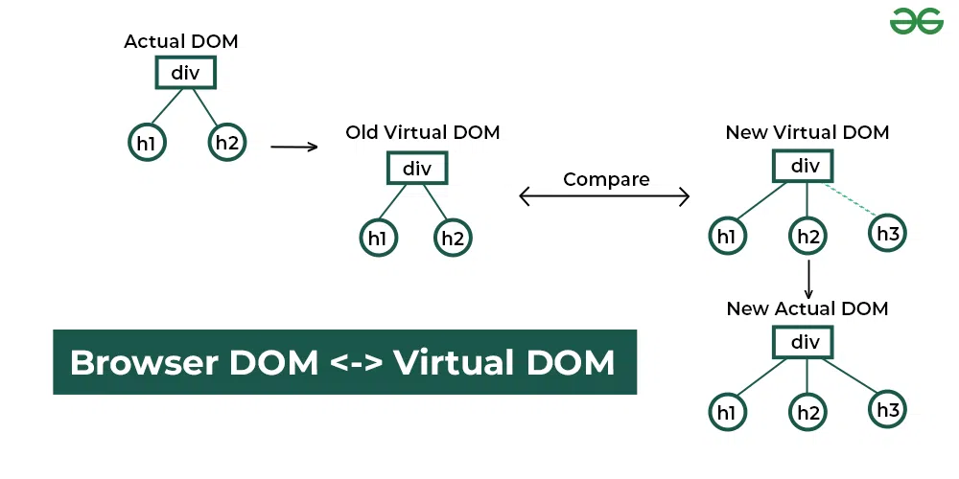
Why React?
What is a Virtual DOM?
Lightweight Copy of the Real DOM
Diffing Algorithm
Batch Updates
Virtual DOM

Slide 9
Why React?
DIV
DIV
h1
h1
p
p
Regular DOM
Virtual DOM

Slide 10
Why React?
Add <a> Tag
DIV
DIV
h1
h1
p
p
Regular DOM
Virtual DOM

Slide 11
Why React?
DIV
DIV
DIV
Compare
h1
h1
h1
a
p
p
p
Regular DOM
The browser parses the HTML to find the node to append.
Append the new node.
Recalculates the CSS for the parent and child nodes.
Update the layout.
Finally, traverse the tree and paint it on the screen(browser) display.
Old Virtual DOM
New Virtual DOM

Slide 12
Why React?
DIV
DIV
h1
a
p
Regular DOM
Batch Update

Slide 13
Why React?
DIV
DIV
h1
h1
a
p
Regular DOM
Updated
DOM

Slide 14
Why React?
DIV
DIV
h1
h1
a
p
p
Regular DOM
Updated
DOM

Slide 15
Why React?
DIV
DIV
DIV
h1
h1
a
h1
a
p
p
p
Regular DOM
Updated
DOM

Slide 16
React Concepts
useState()
A React Hook: Introduced in React 16.8 to enable state management in functional components.
Declares State Variables: Allows you to add state to function components previously stateless.
How to Use useState?
Import from React: import { useState } from 'react’;
Syntax: const [stateVariable, setStateFunction] = useState(initialValue);
Returns Two Values:
The current state value (stateVariable).
A function to update the state (setStateFunction).

Slide 17
React Concepts
useEffect()
A React hook that allows you to perform side effects in function components.
Side effects include data fetching, subscriptions, or manually changing the DOM.
When Does useEffect Run?
Runs after every render by default.
Can be configured to run only when specific values change.
How to Control useEffect Execution?
Dependency Array: Specify dependencies to control when the effect runs.
[]: Runs only once after the initial render (componentDidMount).
[dependency]: Runs on initial render and whenever the specified dependency changes.
No array: Runs after every render.

Slide 18
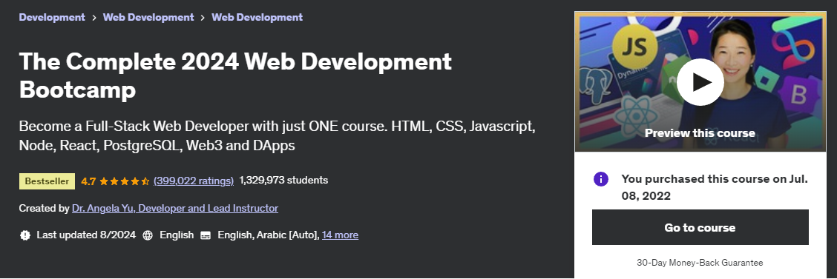
Bonus
Want to Learn Full Stack Development?
Link: https://www.udemy.com/course/the-complete-web-development-bootcamp

Slide 19
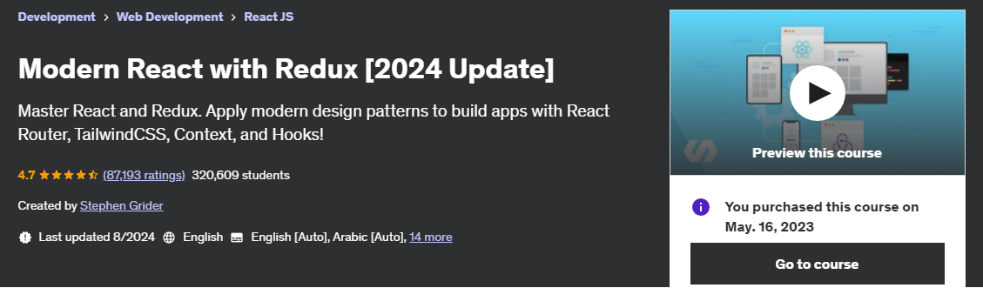
Bonus
Want to master React?
Link: https://www.udemy.com/course/react-redux/

Slide 20
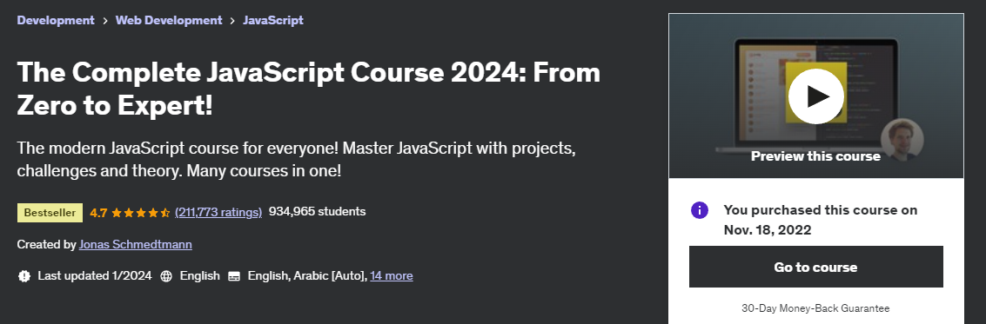
Bonus
Want to master JavaScript?
Link: https://www.udemy.com/course/the-complete-javascript-course/

Slide 21

Bonus
Want to master DSA?
Link: https://www.youtube.com/watch?v=0bHoB32fuj0&list=PLgUwDviBIf0oF6QL8m22w1hIDC1vJ_BHz

Slide 22

Bonus
Want to master Aptitude?
Link: https://www.youtube.com/@adda247

